Slide 1
Mereena Joy 22pmc137
RAILWAY TICKET
BOOKING

Slide 2
Abstract
JourneyBooker provides customers with an easy-to-use platform for booking and managing rail tickets. To manage the online Train ticket booking. It helps passengers to book train tickets from anywhere. Also, make payment online for it. It helps people to reserve seats at their preferred time. The railway ticket booking system aims to provide an efficient and user-centric solution for booking and managing train tickets.

Slide 3
Requirements
Login credentials: This refers to the ability for customers to create an account and log in to a website or application using a username and password. This allows customers to access personalized features such as saved payment methods, order history, and more.
Customer support: This refers to the ability of customers to get help with any issues they may be experiencing with the services. This can be provided through various channels such as phone, email, chat, or a knowledge base.
Ticket management: This refers to the ability for customers to purchase tickets for travel or any other type of reservation. The ticket management system should allow customers to select the event, date, time, and seat type, as well as provide payment information.
Payment: This refers to the ability for customers to securely pay for their tickets or other products using various payment methods such as credit cards, PayPal, or other digital payment systems.

Slide 4
Requirements
Search: This refers to the ability for customers to search train based on keywords or filters such as place or train name, and date.
Print: This refers to the ability for customers to print the ticket.
Customer account management: This refers to the ability of customers to manage their account information, including updating personal details

Slide 5
Features And Highlights
Seamless and user-friendly login process for customers.
Comprehensive customer support options for prompt assistance.
Convenient ticket purchasing with flexible options for events, dates, and seat types.
Secure and hassle-free payment methods for transactions.
Efficient search functionality to find desired trains based on specific criteria.
Easy ticket printing for offline usage and convenience during travel.
User-friendly account management for customers to update and manage their information

Slide 6
Architecture
Front-End Interface: The front-end component would consist of a user interface that allows patients to view available doctors, and their schedules, and book appointments. It should be user-friendly and accessible from various devices such as desktops, tablets, and mobile phones.
Application Layer: The application layer acts as an intermediary between the front-end and the back-end components. It handles user requests, processes data, and communicates with the database and external services. This layer includes components such as API endpoints, authentication, and authorization mechanisms.
Database: A database is crucial for storing and managing various types of data, including patient details, doctor profiles, appointment schedules, and booking records. You can use a relational database management system (RDBMS) like MySQL or PostgreSQL, or consider a NoSQL database like MongoDB if you require more flexibility in data structures.

Slide 7
THIRD-PARTY LIBRARIES
Django Jazzmin: It provides a customizable and feature-rich administration interface for Django projects. Jazzmin aims to enhance the default Django admin interface by adding various enhancements and modern design elements.
Stripe API: The Stripe API provides a wide range of functionalities, making it easy to handle various payment-related tasks programmatically. It is a popular payment gateway that allows businesses to accept online payments securely and efficiently.

Slide 8
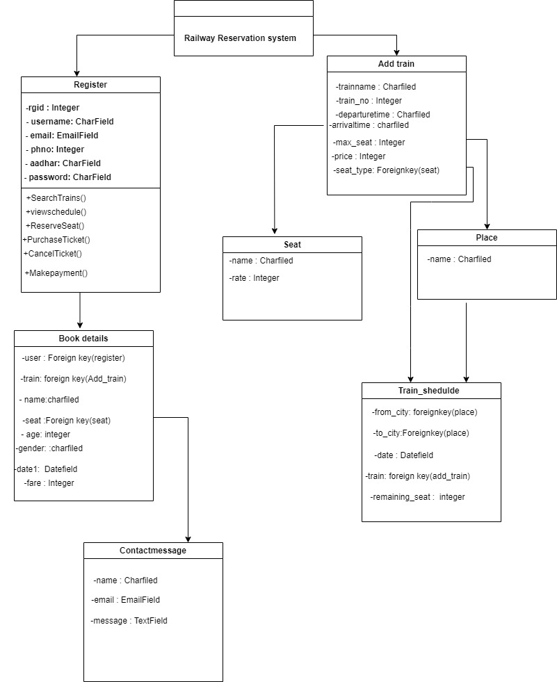
CLASS DIAGRAM

Slide 9
CHALLENGES FACED
Handling data validation and ensuring data integrity during various operations.
Integrating the inventory system with Django libraries .
Creating a user-friendly interface that is intuitive and easy to navigate.
I faced difficulties in using and learning about third-party libraries. Had to refer to different documentation to get a good understanding of these libraries.

Slide 10
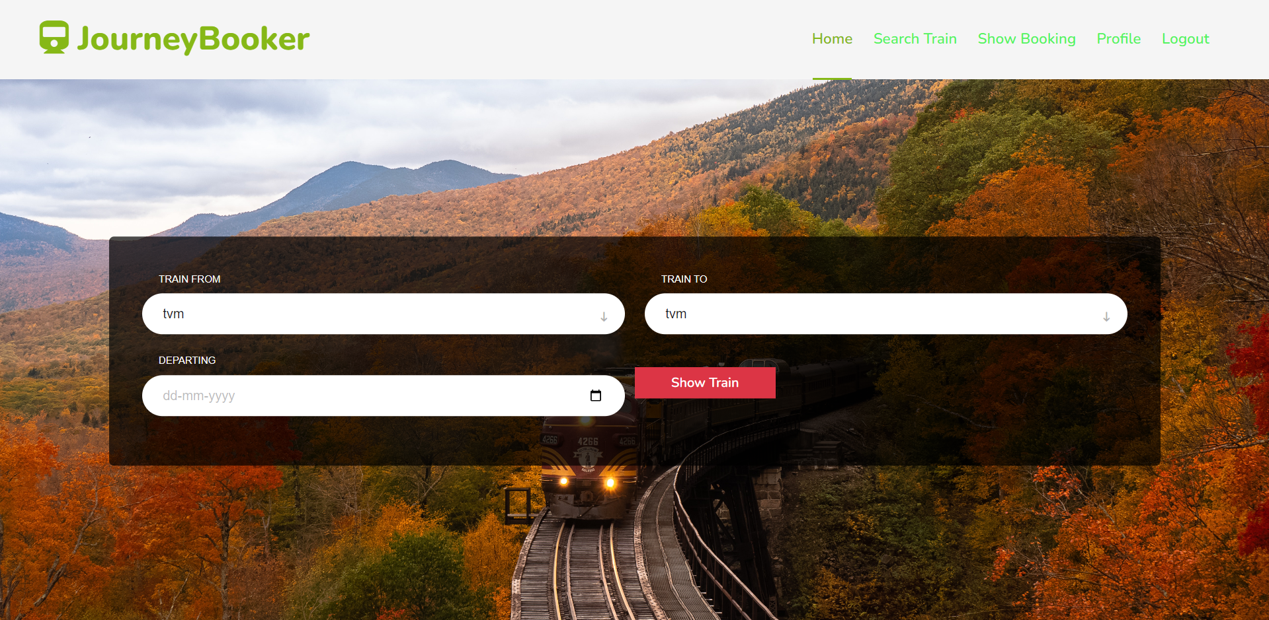
SCREENSHOTS
Here the user can search the available train through the keywords
Notes:
User can search the train

Slide 11
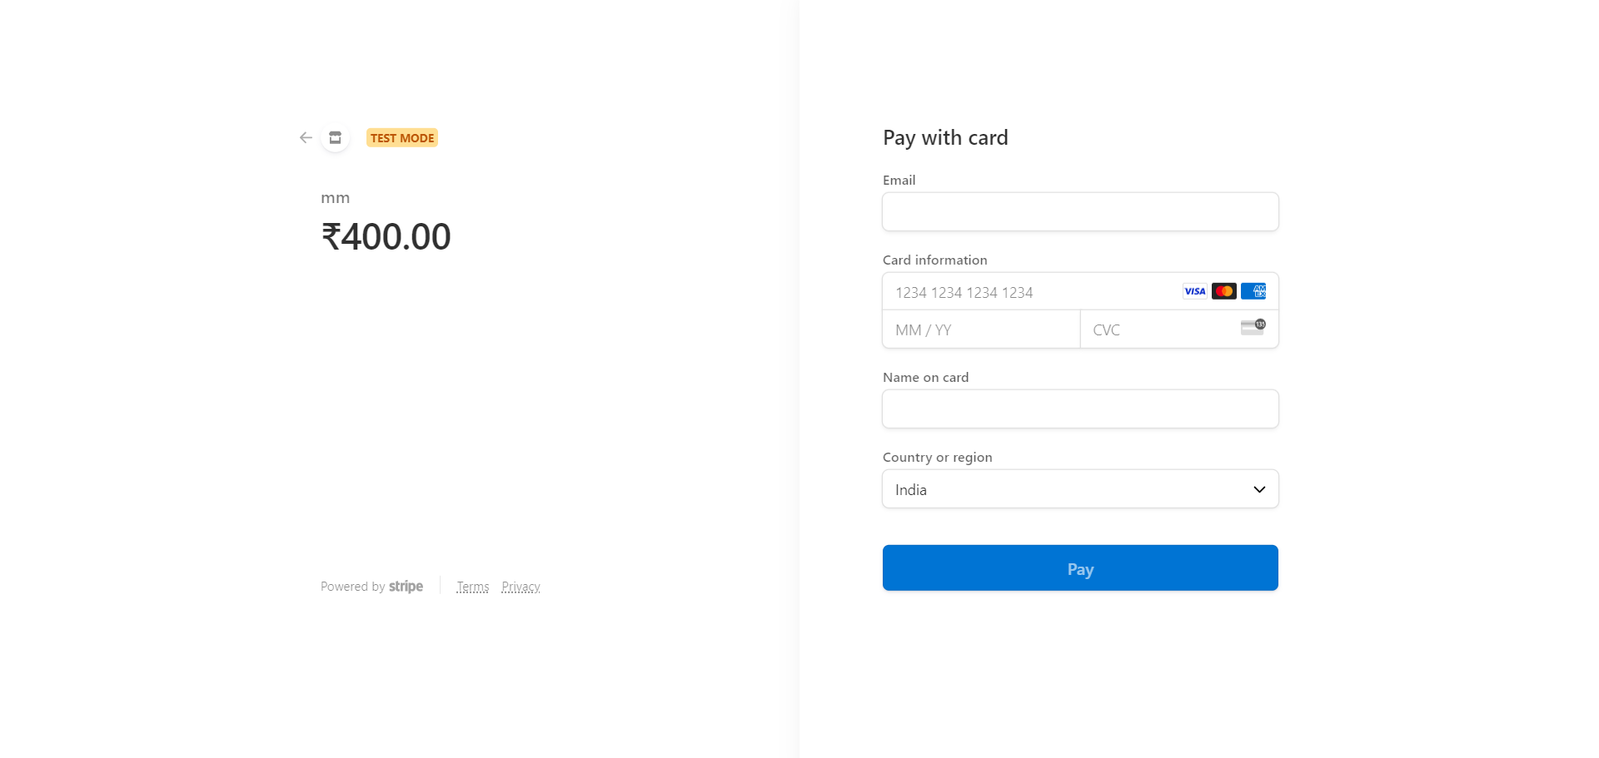
After successfully booking the tickets it will direct you to the payment section to make the payment.

Slide 12
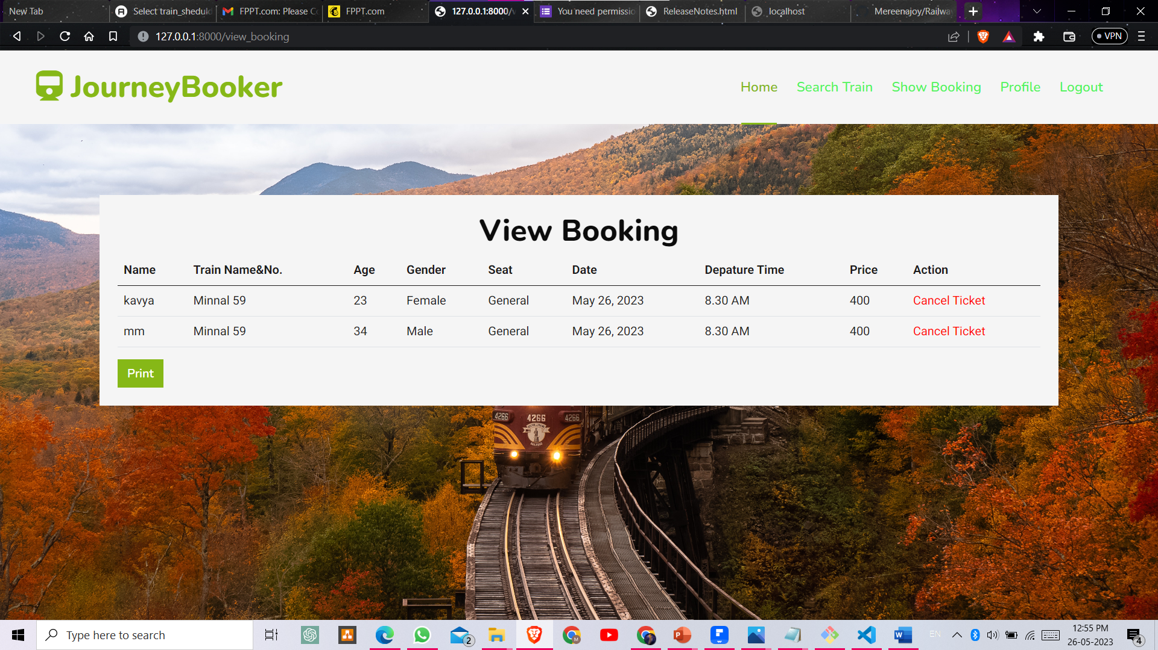
On this page, users can view the booking details and he/she can print the e-ticket

Slide 13
FUTURE ENHACEMENTS
Adding Route: Adding routes in-between stations can be added in the future.
Live tracking: The user should be able to track the route there are traveling.
Mobile application: The introduction of a mobile application can also be done so that this system becomes more user-friendly.
OTP verification: For verifying the user, a unique verification code is to the user-provided email or phone number.

Slide 14
CONCLUSION
JourneyBook's primary objective is to simplify and streamline the ticket reservation process for railway travel. Through the utilization of technology and automation, the project offers various advantages to both users and railway authorities. The website features a user-friendly interface that allows individuals to effortlessly search for train availability based on keywords such as places, dates, and train names. This convenient functionality empowers users to efficiently book their desired train and proceed with secure payment transactions.

Slide 15
REFERENCES
https://dev.to/thearjun/integrate-django-jazzmin-theme-to-django-admin-adminlte-dashboard-5aao
https://docs.djangoproject.com/en/4.2/
https://stripe.com/docs

